Slide 1
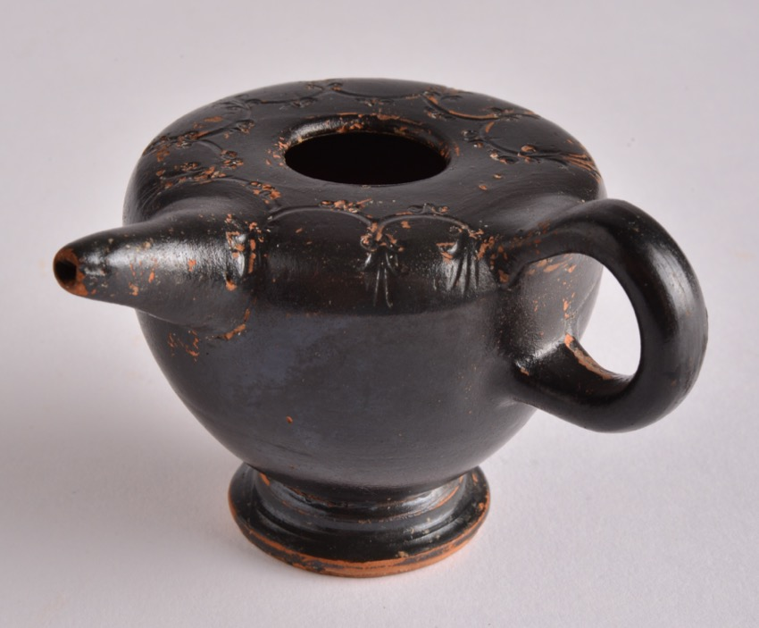
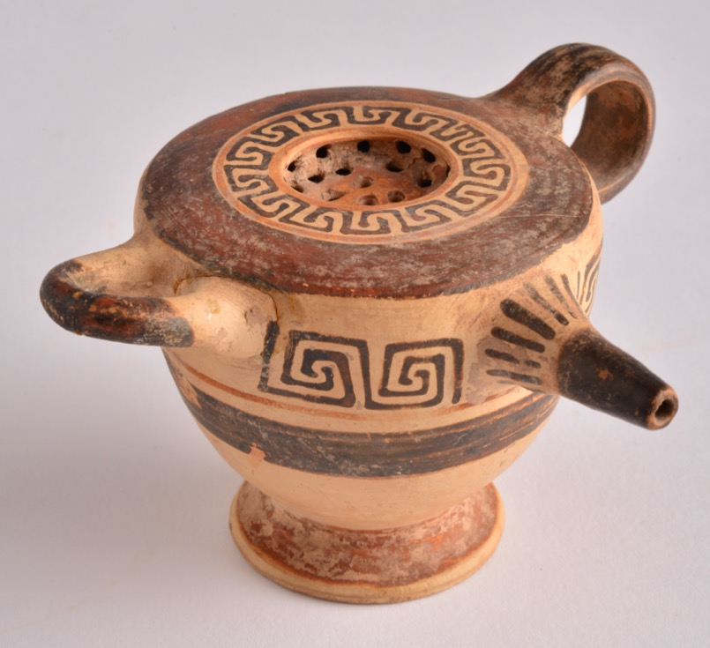
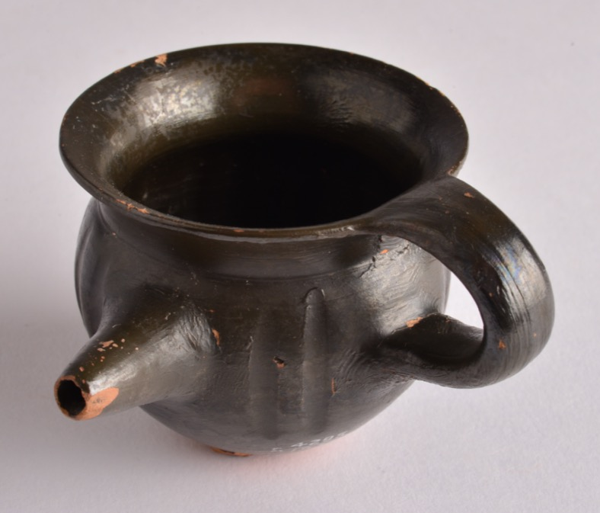
EATING AND DRINKING Children in Ancient Greece

Slide 2
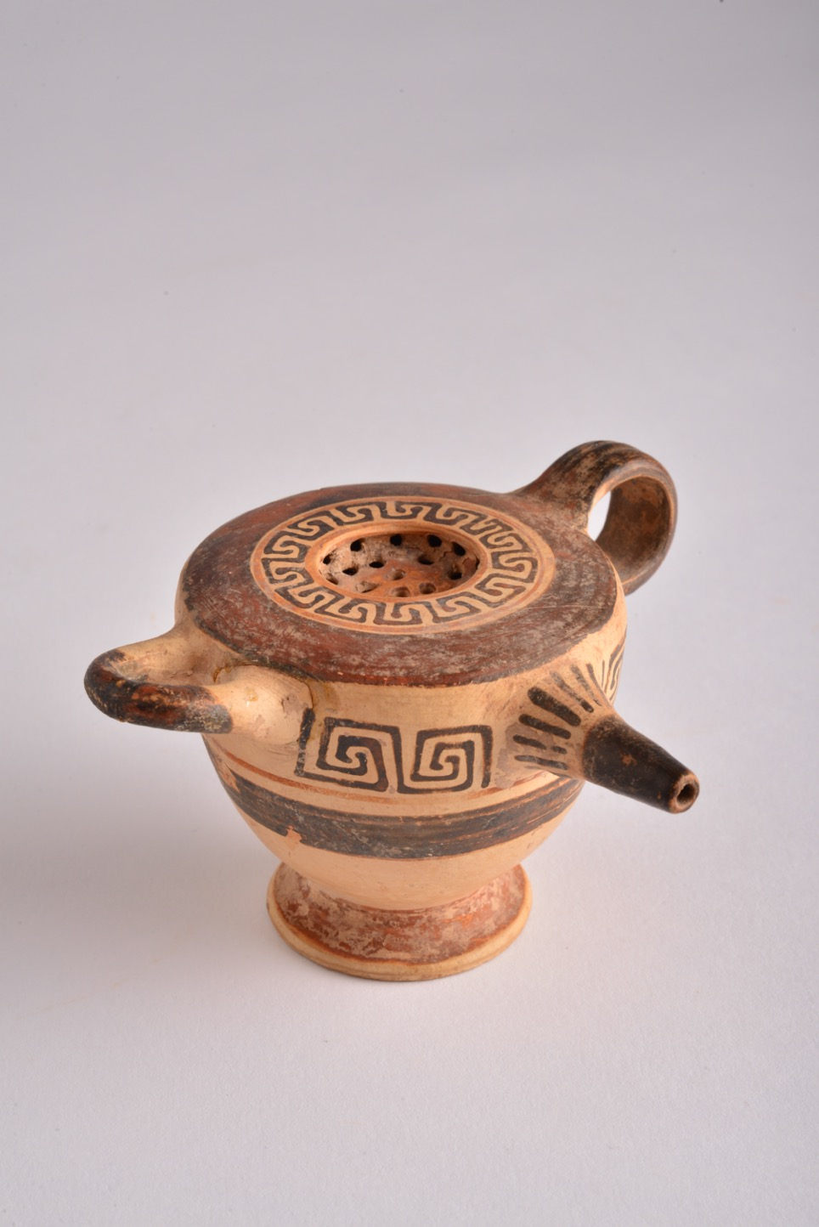
Feeder (123)
The artefact we are looking at today is a feeder. It can also be called a feeding cup.
Feeders would be used to feed very young children with milk – like a baby’s bottle or ‘sippy’ cup today.
123 is the feeder’s accession number – this is the special number used (like a name) to identify the feeding cup in the Great North Museum: Hancock.
The feeder was made in Corinth, in the south of Greece, between 600 and 575 BCE – so around 2600 years ago.
The feeder is made from clay. It was decorated with paint and then fired in a kiln (a very hot oven).

Slide 3
Feeder (123)
The feeder has a sieve built into the top.
Can you see the holes?
The feeder has a spout, to make it easier for babies to drink from it without spilling their milk.
Can you see the hole?
The feeder has two different handles.
Can you see how they are different shapes?
The feeder is decorated in a Geometric style, with black and brown paint. Geometric styles used different repeated patterns made from lines
How many different patterns can you see?

Slide 4
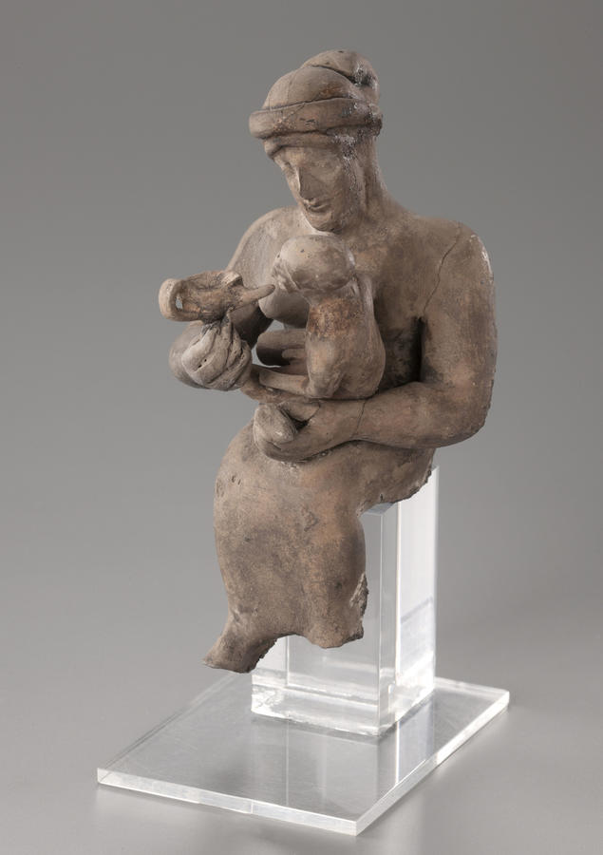
Using Feeders Drinking in Ancient Greece
This picture shows a clay figurine from ancient Greece.
The figurine shows a lady feeding a baby using a feeder.
Can you see the baby?
Can you see the feeder?

Slide 5
More Feeders
These are some other feeders from ancient Greece that are kept in the Shefton Collection in the Great North Museum: Hancock.
You can see they are a little different from number 123 – their decoration is different, they do not have sieves on the top, and they only have one handle. They all have a spout though, don’t they?

